Slide 1
Airport Data Analysis
Sanjesh Chourasia

Slide 2
PROJECT CONTENT
ABOUT PROJECT
ABOUT DATA
INSIDES TO BE FOUND
VISUAL ANALYSIS
KEY FINDING
DASHBOARD VIEW

Slide 3
ABOUT PROJECT
The purpose of data analytics in aviation is to examine the vast amount of data generated daily and provide useful information to airlines, airports, and other aviation stakeholders so that they can improve their operational planning and execution, as well as any related products and services.

Slide 4
ABOUT DATA
For this project, I am using the airport dataset.
This dataset is present in the form of an excel workbook.
Contain 88533 rows and 17 columns
Some of the important features for our analysis are Date, Geometry, Route, Route 1, Route 2, Event, Flight No, and Gate columns.

Slide 5
INSIDES TO BE FOUND?
What is the total number of flights?
Which is the most popular day?
Which is the most popular route?
Which is the longest route?
What is the total length of the longest route in km?

Slide 6

VISUAL ANALYSIS
Total No. of Flights: -
Total number of flights is equal to 88,532.

Slide 7
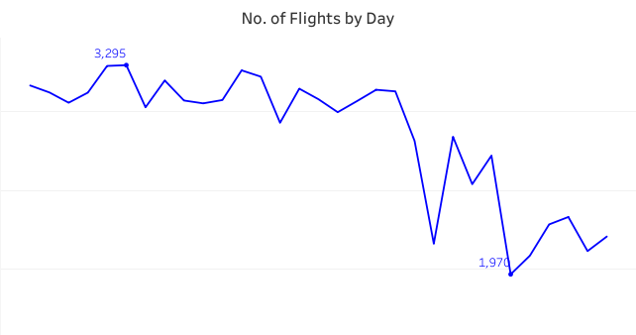
VISUAL ANALYSIS
No. of Flights by Day.
Maximum No. of Flight on a particular Day is 3295
Minimum No. of Flight on a particular Day is 1970

Slide 8
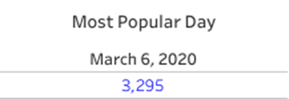
VISUAL ANALYSIS
Most Popular Day.
6th March 2020, is the most popular day
No. of flights on that day is 3,295

Slide 9
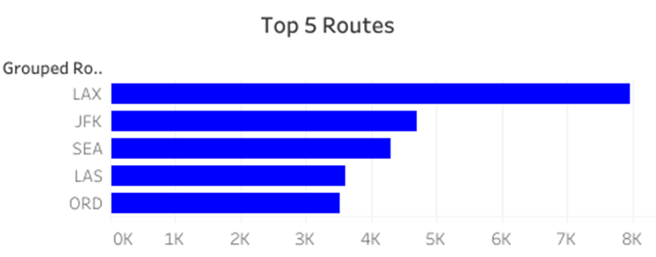
VISUAL ANALYSIS
Top 5 Routes.
LAX is the most popular route
JFX is the second most popular route

Slide 10
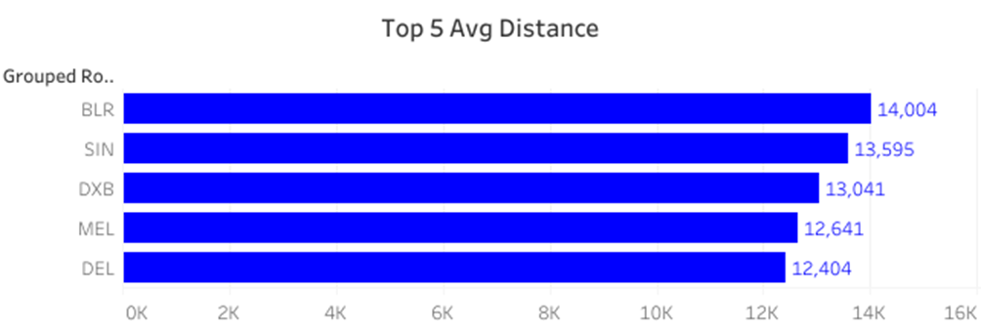
VISUAL ANALYSIS
Top 5 Average Distance.
Route BLR is the longest route
It is 14004 km long

Slide 11
KEY FINDING
Q1. What is the total number of flights?
There are a total of 88,532 flights.
Q2. Which is the most popular day?
6th March 2020, is the most popular day and no. of flights on that day is 3,295.
Q3. Which is the most popular route?
LAX is the most popular route

Slide 12
KEY FINDING
Q4 Which is the longest route?
Route BLR is the longest route
Q5 What is the total length of the longest route in km?
The total length of route BLR is 14004 km

Slide 13
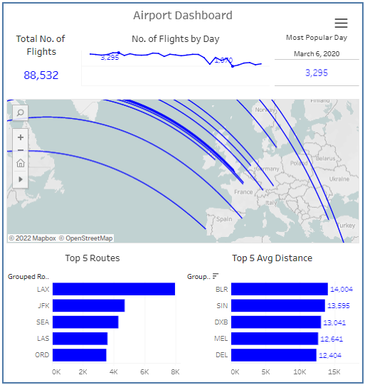
DASHBOARD VIEW

